Slide 1
Learning-based and data-driven TCP Design for Memory-constrained IoT
2016 IEEE - International Conference on Distributed Computing in Sensor Systems
Wei Li, Fan Zhou, Waleed Meleis and Kaushik Chowdhury
Dept. of Electrical and Computer Engineering
Northeastern University
Boston, USA
311552001 林湘羚

Slide 2
Abstract
Pervasive deployment of IoT devices
The need for continuous connections with high reliability necessitate re-thinking of conventional design of the transport layer protocol.
Using Q-learning in TCP cwnd adaptation, allowing the protocol to immediately respond to previously seen network conditions.
Propose ways to reduce memory overhead through function approximation while maintaining the same throughput and delay.
33.8% and 12.1% improvement in throughput and delay

Slide 3
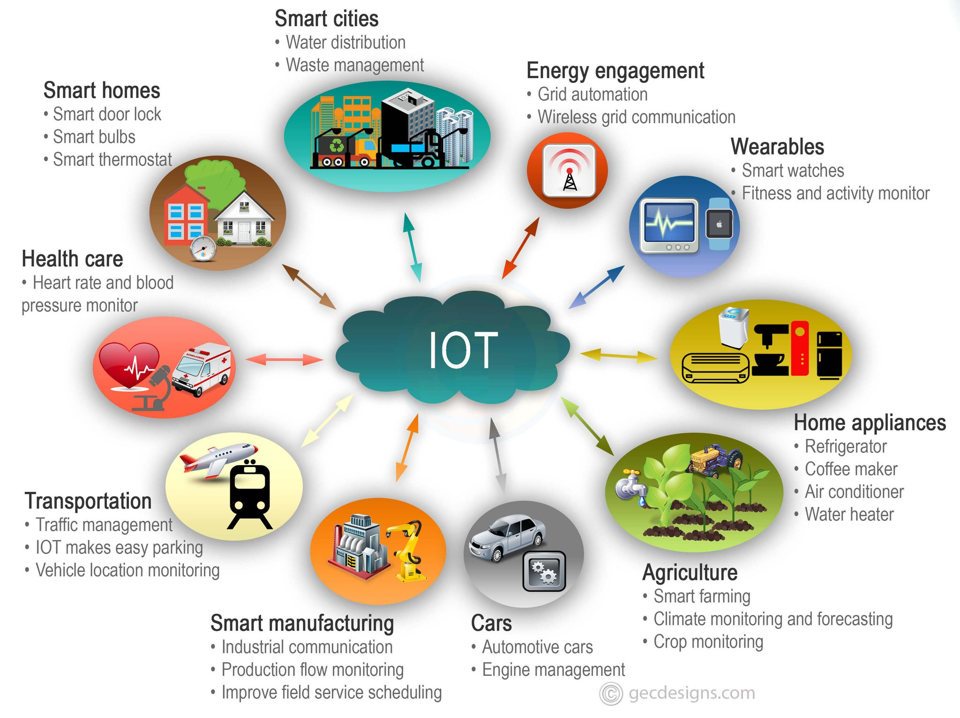
Introduction
Need high throughput and low delay
Choosing TCP for reliable end to end delivery
Propose a new technique for TCP cwnd adaptation based on Q-learning, called TCPLearning
CMAC and fuzzy Kanerva-based function approximation
https://pbs.twimg.com/media/Dj1X28-V4AEtyIg.jpg:large

Slide 4
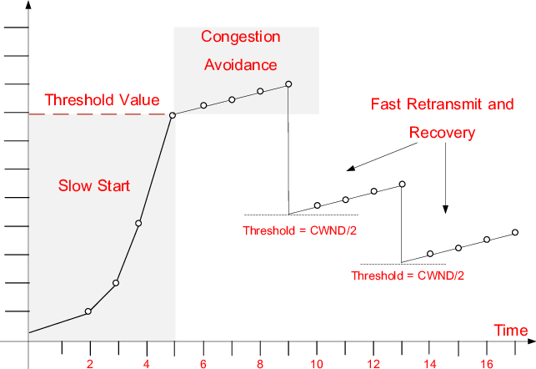
TCP New Reno
tcp new reno congestion avoidance - Bing images

Slide 5
Contribution
Propose a self-learning and unsupervised TCP cwnd adaptation technique based on Q-learning
Using function approximation technique to reduce memory requirement
CMAC
Fuzzy Kanerva
Packet level simulations

Slide 6
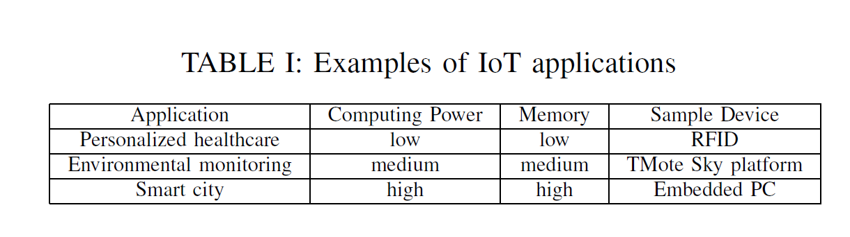
Motivation and practical relevance

Slide 7
Related work
Algorithm | Approach | Disadvantage
Cubic | Using fixed function | Cannot adapt to the complexity and rapid evolution of modern data networks
Vegas
Westwood
Fast
Remy | Off-line training | Cannot adapt to continuously varying network environment
PCC | Online learning | Dose not exploit memory of previous experiences and their outcomes

Slide 8
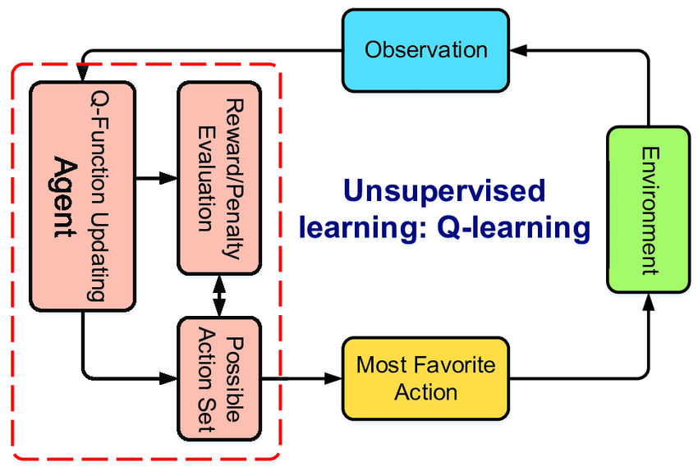
Q-Learning-based TCP / TCPLearning
Example of reinforcement learning: Q-learning. | Download Scientific Diagram (researchgate.net)

Slide 9
Q-Learning-based TCP / TCPLearning
congestion avoidance phase
TCPLearning
Packet loss
TCP New Reno
Fast recovery / retransmission
cwnd>threshold
Slow start
congestion observed
TCP New Reno

Slide 10
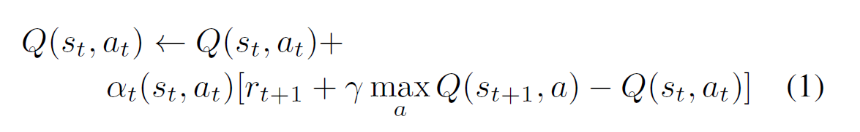
Q-Learning-based TCP / TCPLearning
Utility function
Action-value function
<-(1- α_{t}(s_{t}, a_{t})) Q(s_{t} , a_{t}) + α_{t}(s_{t}, a_{t}) [r_{t+1} + γ max_{a} Q(s_{t+1}, a)]
Four state variables
A moving average of the inter-arrival time between newly received ACKs, discretized into 10 intervals
A moving average of the inter-arrival time between packets sent by the sender, discretized into 10 intervals
The ratio between current RTT and the best RTT found so far, discretized into 10 intervals
The slow start threshold, discretized into 10 intervals

Slide 11
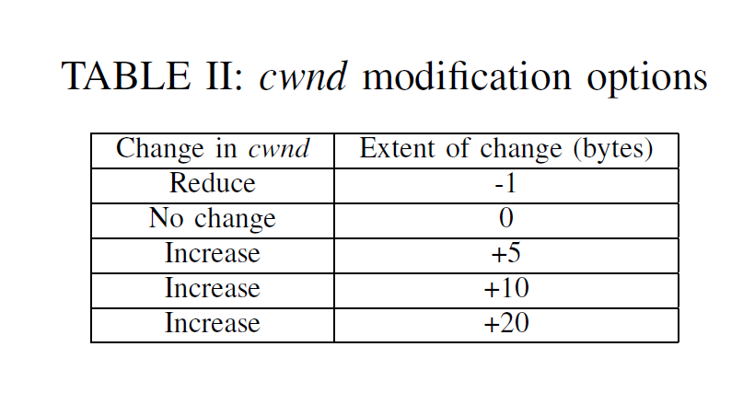
Q-Learning-based TCP / TCPLearning
Available actions
Reward function
+2, if the utility increases
-2, if the utility decreases

Slide 12
Fuzzy Kanerva-based TCP Q-Learning
The Q-table is typically large
Limit the size and complexity of the learning problems
Function approximation may be needed to store an approximation of the entire discretized table to further reduce the memory cost

Slide 13
CMAC / Tile coding
Cerebellar Model Articulation Controller
Using small tiles (finer grain) can improve precision but increases learning time
Using large tiles (coarse grain) with a number of tilings can provide fine grain generalization
Consume less memory while maintaining comparable performance than TCPLearning

Slide 14
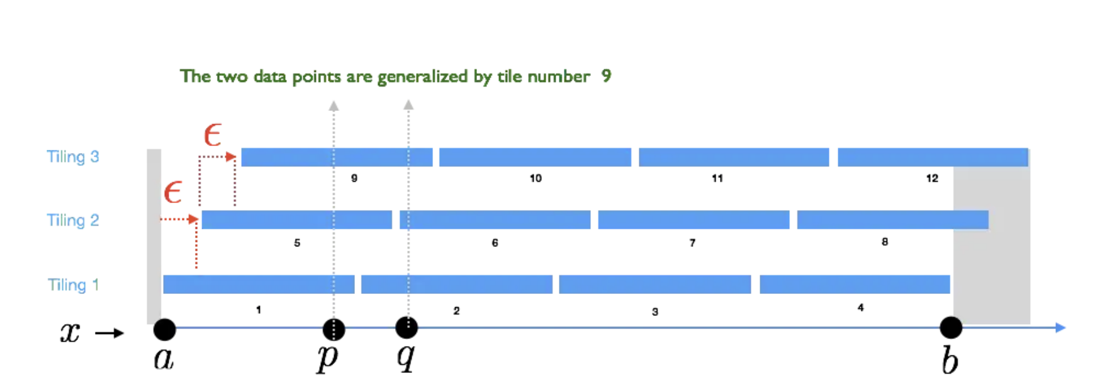
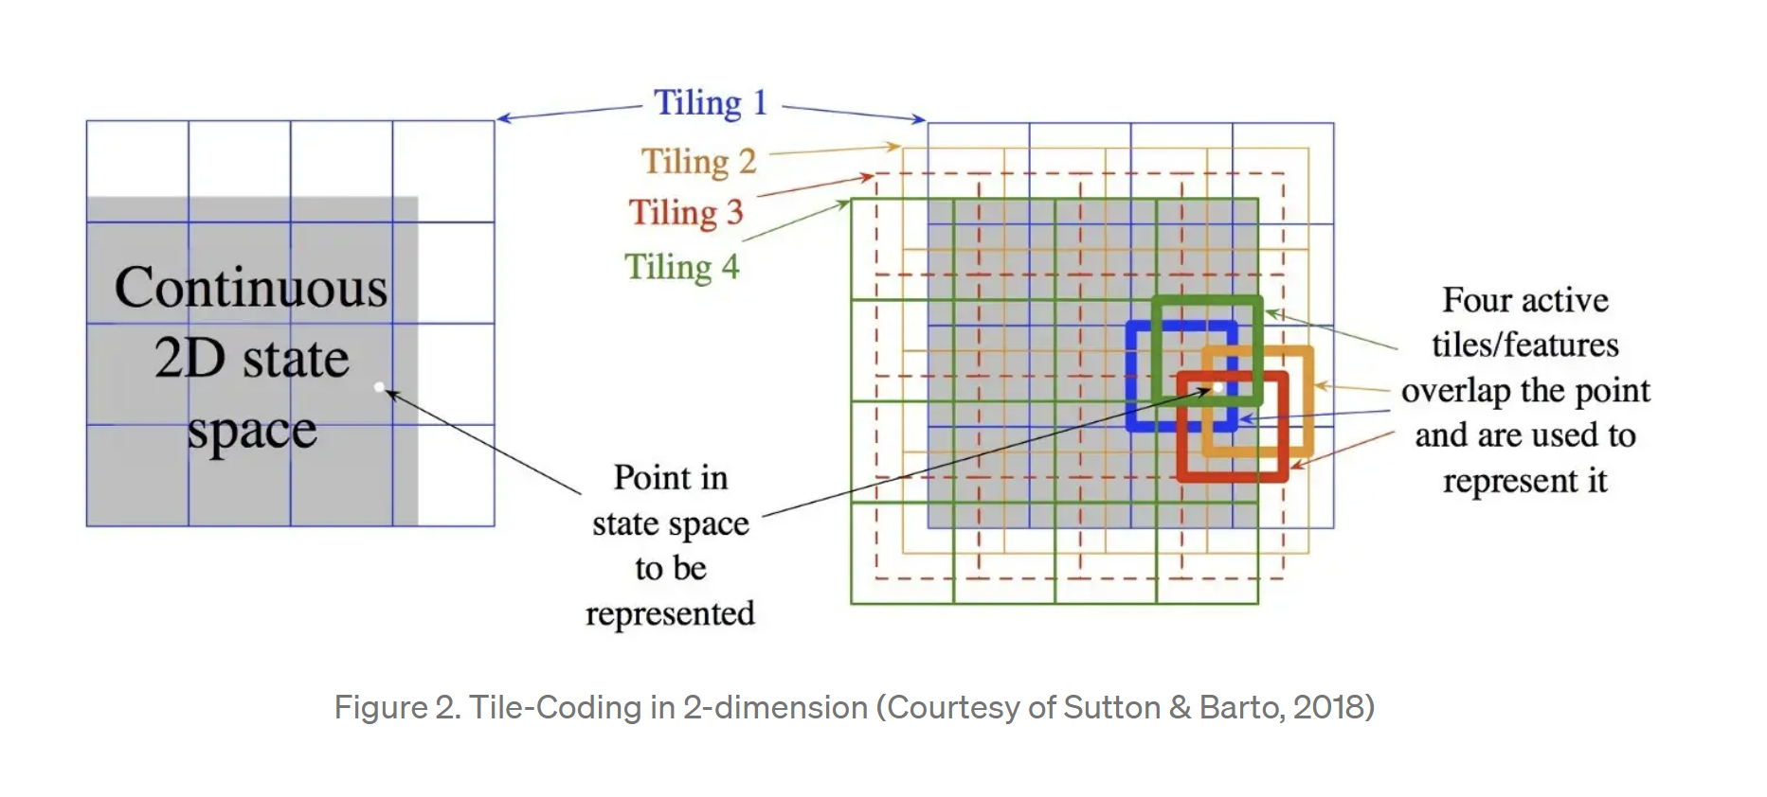
CMAC / Tile coding
Tile-Coding: An Efficient Sparse-Coding Method for Real-Valued Data | by Hamid Maei | Criteo R&D Blog | Medium

Slide 15
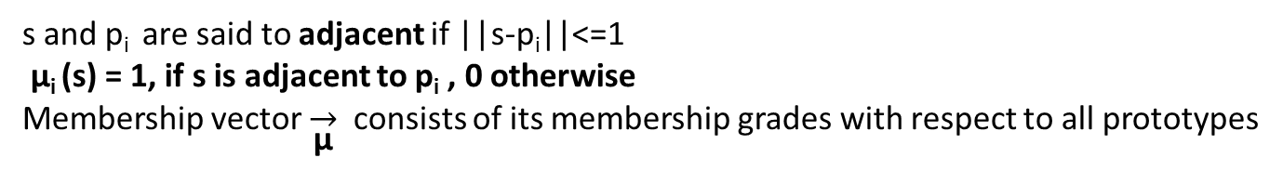
Fuzzy Kanerva-based TCP Q-learning
state
Approximation value of state-action value Q
A sequence of state-variables of the domain
Q(s) = Σ_{i} θ(i) μ_{i} (s)
prototypes
A collection of k prototype state-action pairs is selected
s: a state-action pair
p_{i}: a prototype
||s-p_{i}||: number of state-variables whose values differ between them, plus 1 if the action values differ
A value θ(i) is maintained for the ith prototype
Membership grade μ
s and p_{i} are said to adjacent if ||s-p_{i}||<=1
μ_{i} (s) = 1, if s is adjacent to p_{i} , 0 otherwise
Membership vector $\overset{→}{\text{μ}}$ consists of its membership grades with respect to all prototypes

Slide 16
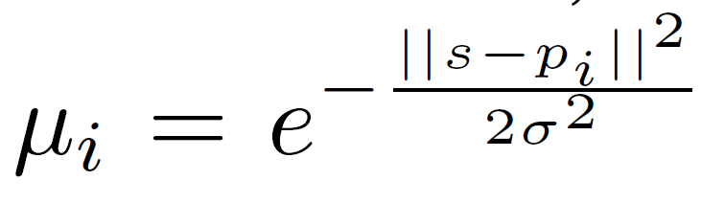
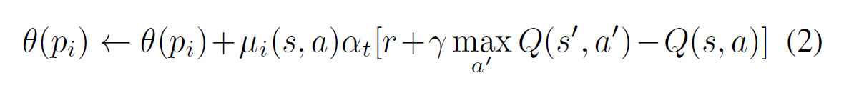
Fuzzy Kanerva-based TCP Q-learning
prototype collision problem
If two state-action pairs have the same membership vector, a prototype collision is said to have taken place
Allow a state-action pair to update θ-values of all prototypes

Slide 17
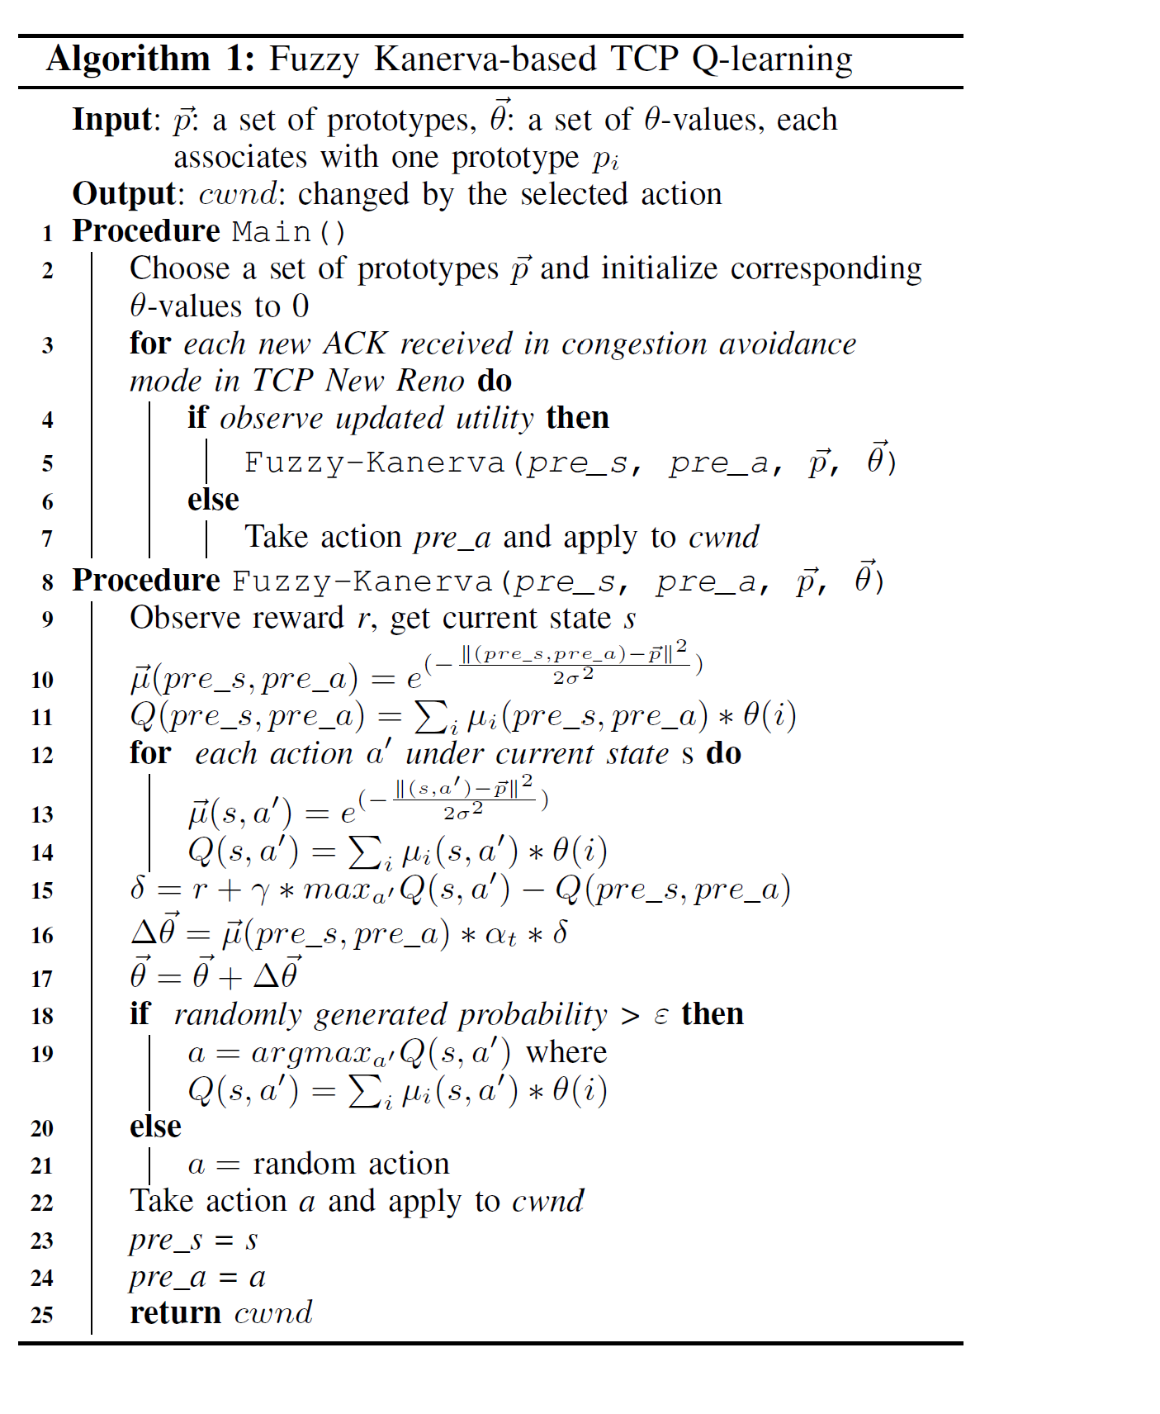

Slide 18
Time and Space complexity
Time
O(|A||S||P|)
Space
O(|P|)
A: all possible action number
S: all state variable number
P: prototype number

Slide 19
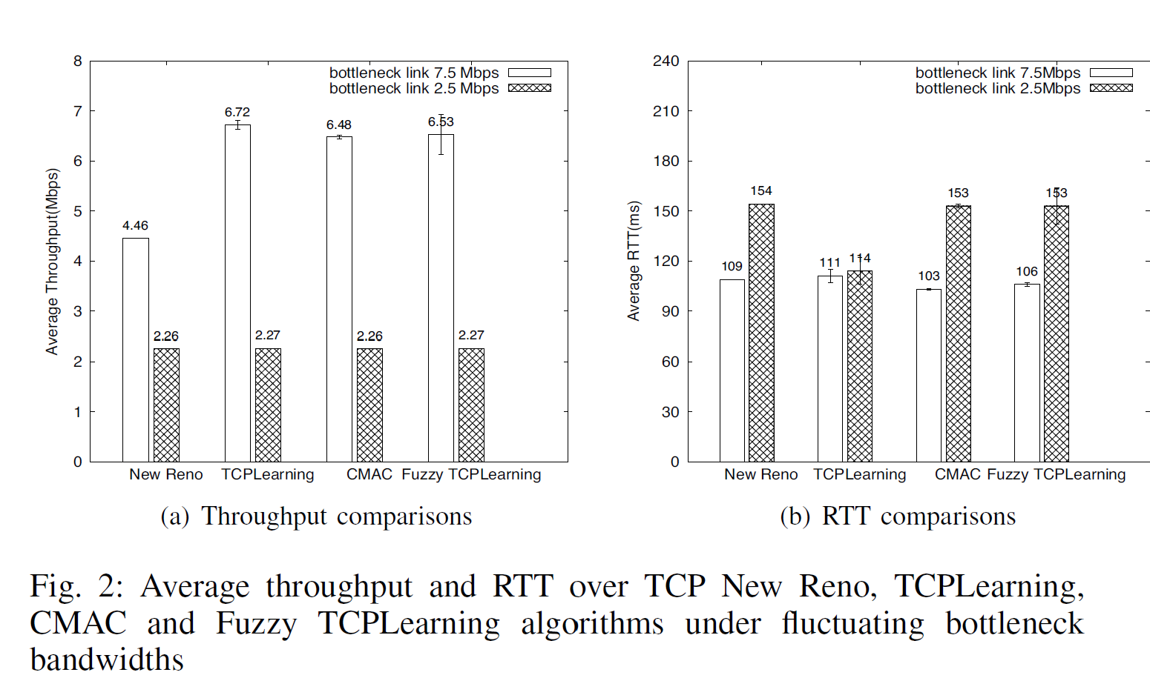
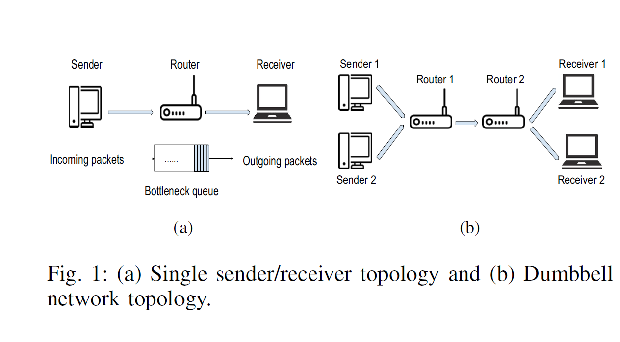
Performance evaluation
CMAC
5 tilings
3,125 tiles per tiling
Fuzzy TCPLearning
100 prototypes (random)
Controlled environment:
ns-3 based packet level simulation
Bottleneck bandwidth switch between 7.5Mbps and 2.5 Mbps every 800s
RTT -> 100ms
Buffer size -> 50 packets (BDP)
TCPLearning
Exploration rate Ɛ -> 0.1
Initial learning rate α -> 0.3

Slide 20
Performance evaluation - Impact of Reduced Memory Use
TCPLearning
50,000 * 4 = 200KB
CMAC
15,625 * 4 = 62.5KB
Fuzzy TCPLearning
100 * 20 + 100 * 4 = 2.4KB

Slide 21
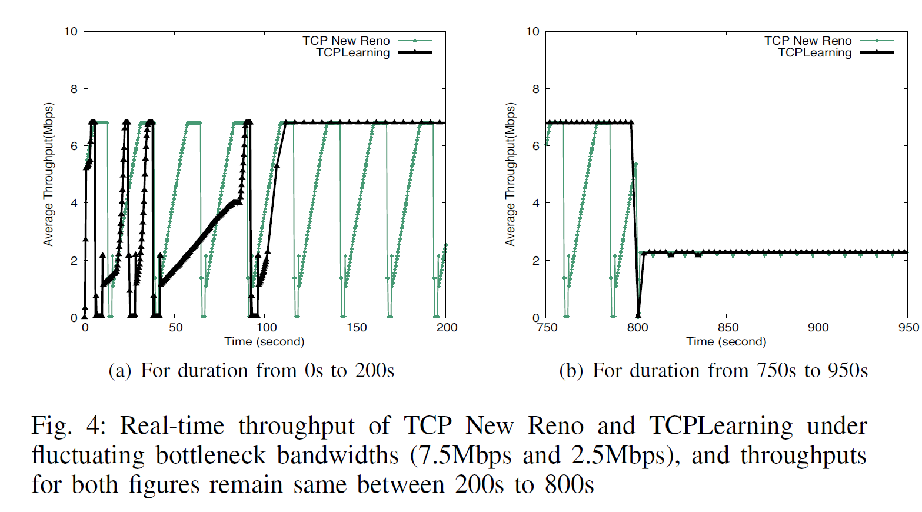
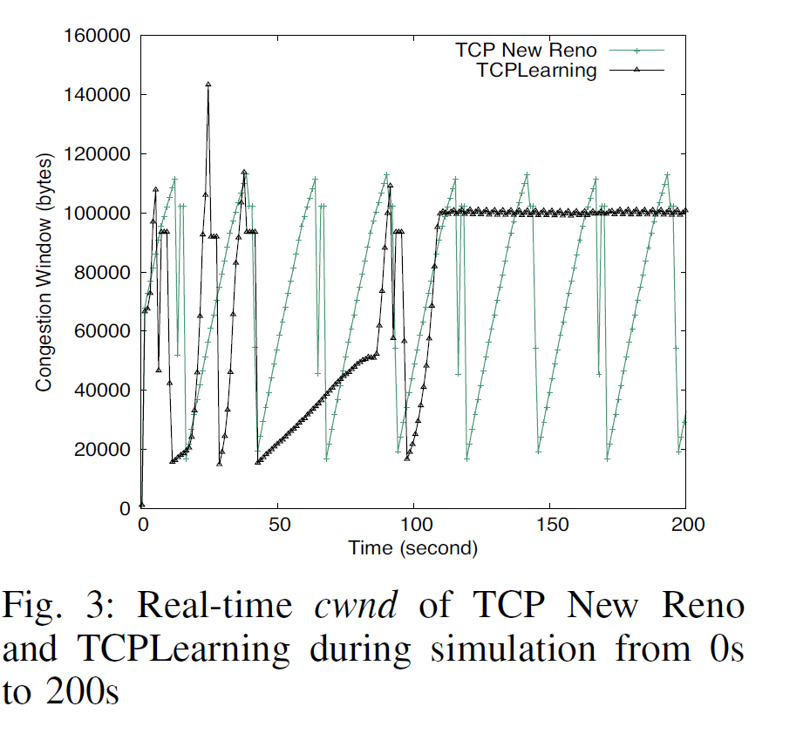
Performance evaluation

Slide 22
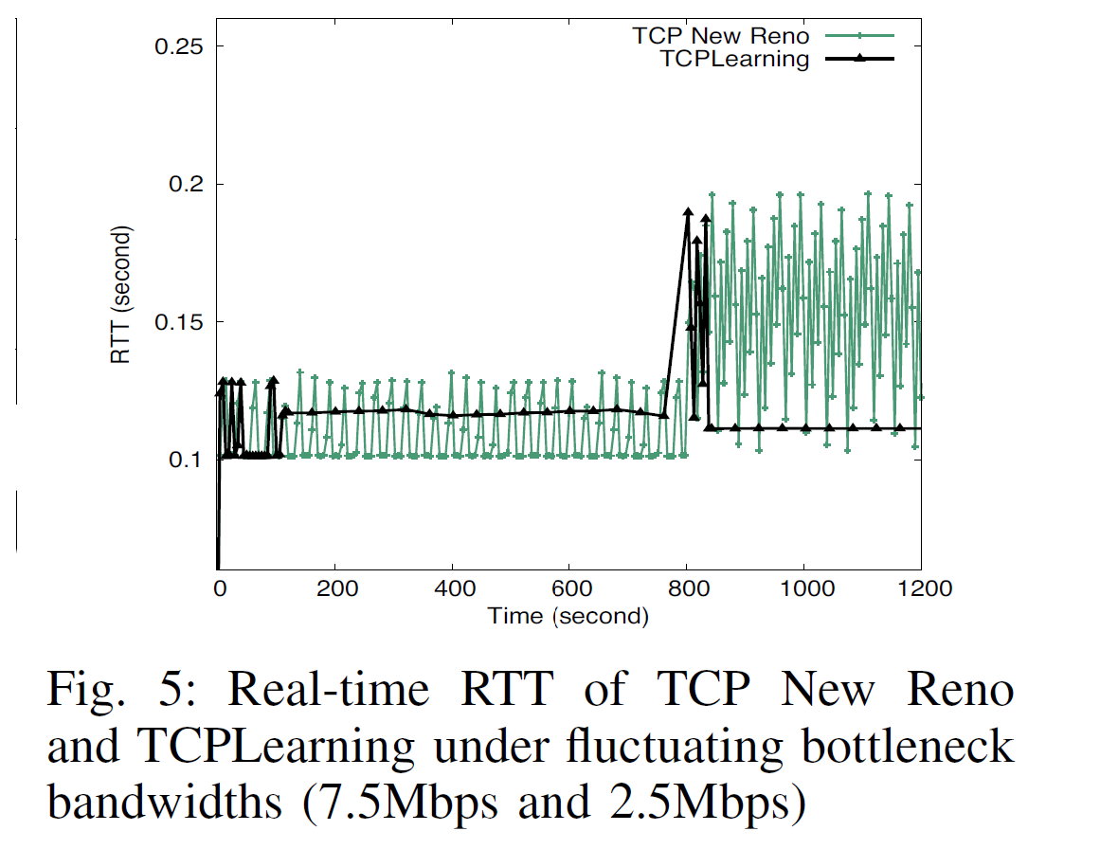
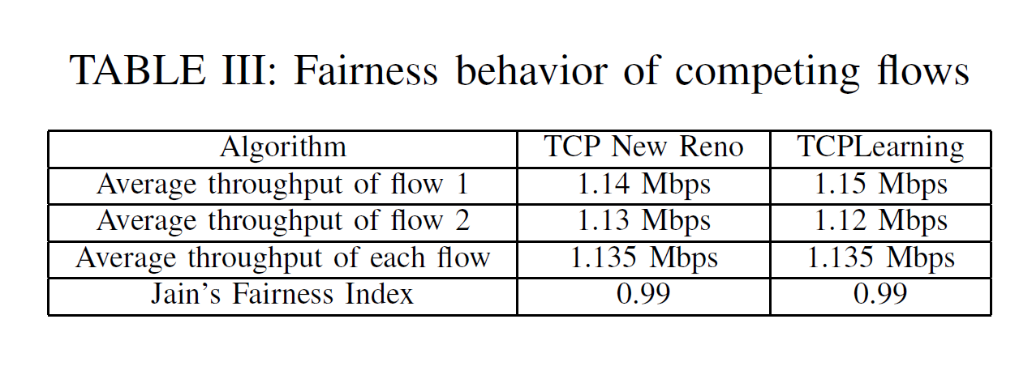
Performance evaluation

Slide 23
Conclusion
A novel Q-learning based TCP (TCPLearning)
Achieve better throughput and delay performance than TCP New Reno
Introduce function approximation techniques to reduce the memory usage
CMAC uses less than 1/3 of memory than TCPLearning
Fuzzy TCPLearning uses 1.2% of the memory needed by TCPLearning

Slide 24
Thanks for listening

